Slide 1
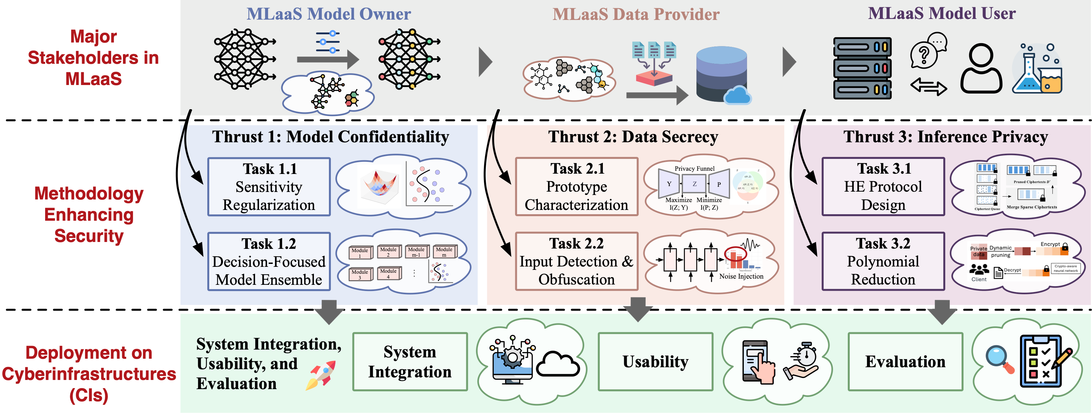
Secure Machine Learning as a Service for Collaborative Scientific Research PI: Yushun Dong (Florida State University) Co-PIs: Neil Gong (Duke University), Mengxin Zheng (University of Central Florida)
Collaboration and Usability Challenge Addressed
Model extraction attacks (MEAs) → theft of proprietary models.
Model inversion attacks (MIAs) → leakage of sensitive training data.
Inference data breaches → exposure of user queries and outputs.
Technical Cybersecurity Solution
Model Confidentiality: Sensitivity Regularization; Model Ensemble.
Data Secrecy: Privacy Funnel; Suspicious Input Detection&Obfuscation.
Inference Privacy: Efficient Encryption; Dynamic Polynomial Reduction.
Secure MLaaS framework that protects the three stakeholders in collaborative scientific computing environments.
Benefits to Scientific Cyberinfrastructure
Strengthens security, integrity, and reproducibility of MLaaS-based scientific collaboration workflows.
Enhances trust in collaborative CI for sensitive domains (healthcare, disaster response, genomics).
Risks Versus Potential For Advances
Risks: Performance overhead from encryption; resistance to adoption if workflows disrupted; Mitigation: Efficiency-focused design; modular integration; continuous usability feedback loops.
Result Dissemination Plans
Stolen model fidelity↓; reconstructed feature distance↑; encrypted inference latency↓; negligible task-relevant utility loss↓.
Open-source software; Public datasets & benchmarks; Tutorials, user guides, workshops, etc.
Audience: CI admins, domain scientists, research institutions.
Programmatic Details
3 years project starting on Jan. 2026
Led by Florida State University and with Duke University and University of Central Florida
Payoff: A deployable, modular security framework that protects models, data, and inference in collaborative MLaaS environments.
This material is based upon work supported by the National Science Foundation under Grant No. 2530786
Notes:
Yushun Dong
CS
FSU - duke - UCF
accelerate scientific discovery - scientists in various domains - relying on AI capabilities
not running AI on their own - rely on AI inference services - MLaaS - imagine how ChatGPT is helping with your daily life
However, despite the emerging need, trustworthiness of this process can raise the concerns from three stakeholders
data providers
e.g., collaborators from hospitals and healthcare centers - really skeptical with their data being shared
model owner
worry the ML model being stolen - think about how deepseek raised the concern of distilling ChatGPT
model user
worry about their queries being stolen
companies are skeptical about uploading internal documents to the server of service providers such as ChatGPT - they have to train their own model locally instead
--
Work with NWRDC
Florida Northwestern reginal data center
targeting deployment helping their customers
research institutions and univeristies

